Slide 1
SPARK – 2021 Internship @ IITR Probabilistic seismic resilience model for spatially distributed systems
By:
Rajat Shakya
Under the Guidance of
Prof. Saurabh Shiradhonkar

Slide 2
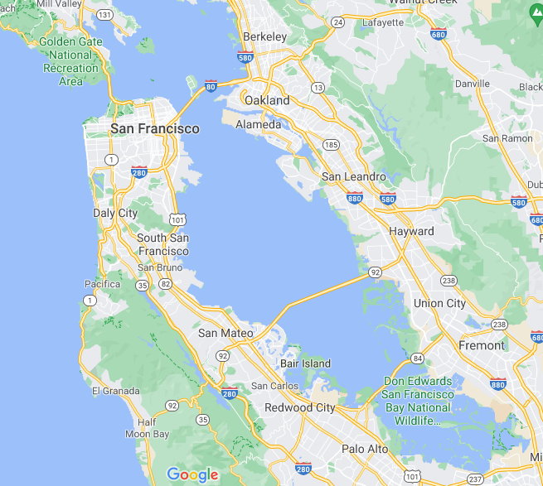
Problem Statement
If there are N spatially distributed bridges, in a seismically active region, how do we determine which bridge to retrofit first?
To develop a framework that will allow the decision on priority of retrofit to be made based on:
- Level of seismic hazard
- Performance of Bridge
- Expected Loss
- Recovery after occurrence of damaging event
Picture Source: Google Maps

Slide 3
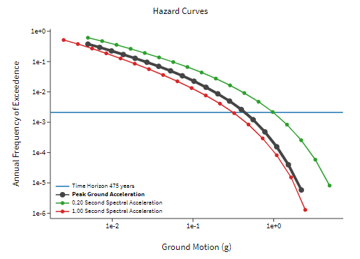

PSHA and Hazard Curve
Seismic Hazard
Probable level of ground shaking associated with the recurrence of earthquakes (Shedlock, 2002)
Measured as Peak Ground Acceleration and/or Spectral Acceleration
Probabilistic Seismic Hazard Assessment
Total hazard due to all possible earthquake scenarios using their probabilities. (Baker, 2008)
Output is Hazard Curves
Relates Hazard at each location with the frequency of exceedence
Fig. Typical Hazard Curves for a location
Figure Source: USGS Unified Hazard Tool

Slide 4
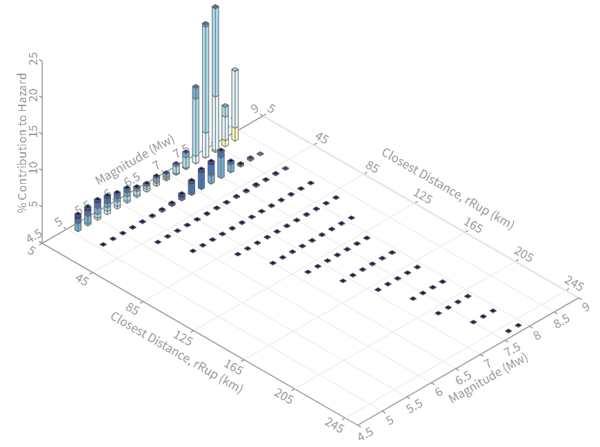
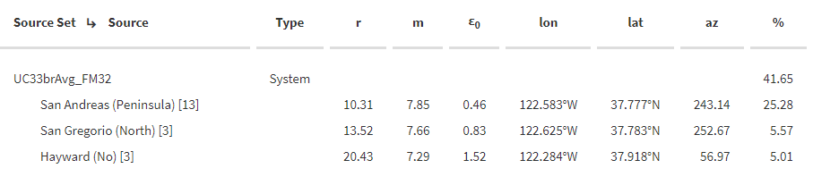
Generation of Scenario Earthquakes from PSHA
The need:
The losses and resilience calculation requires individual scenarios that affect the structure.
Need to identify sources that affect all locations.
Deaggregation:
Splitting of Hazard into contributing sources.
Output is Sources, their contribution in %, and the magnitude, distance pair.
Fig. Typical Deaggregation Graph for a hazard
Fig. Typical Deaggregation Contributor Table for a hazard
Figure Source: USGS Unified Hazard Tool

Slide 5
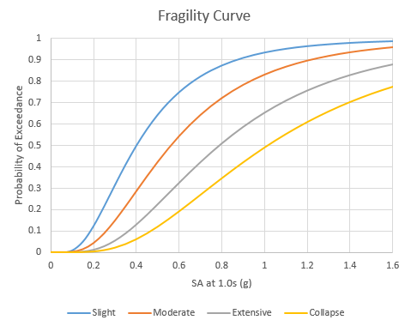
Estimation of Damage States of Bridges
The need:
Losses from an event are incurred due to some damage caused by the event
Expected damage can be translated to expected loss for an event
Fragility Functions
Relates Hazard with exceedance probability of damage state
Damage state associated with mean damage ratio
Damage ratio: repair cost / replacement cost
**Hazards due to different sources are calculated using the Ground Motion Prediction Equations.
Fig. Typical Fragility Curve for a structure
Source: HAZUS-MH MR3, 2003

Slide 6
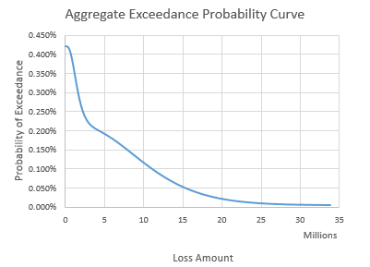
Expected Seismic Losses
How do we combine the individual expected losses to get the total expected loss?
Exeedance Probability Methodology
Uses different exceedance probabilities (EP)
Probability of exceeding certain amount of loss
If an earthquake happens – Conditional EP
Due to at least one earthquake in a year – Occurrence EP
Due to all the earthquakes in a year – Aggregate EP
Average Annual Loss
Expected loss in a given year.
Area under the AEP Curve
Fig. Typical AEP Curve for a structure
Source: RMS™ Exceedance Probability Methodology, 2010

Slide 7
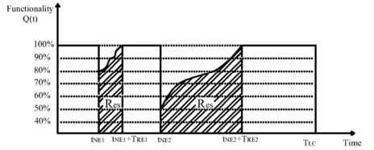
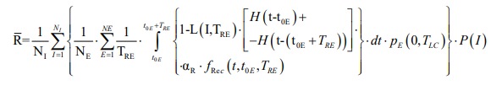
Resilience of Bridges
Can we incorporate loss with the functionality during recovery, and recovery time into a useful parameter?
Resilience
Capability to sustain a level of functionality after damage
Takes into account how often the event can occur in structure’s lifetime
Normalized function
Fig. Typical Recovery Curve for a structure
Source: Cimellaro et al., 2006

Slide 8
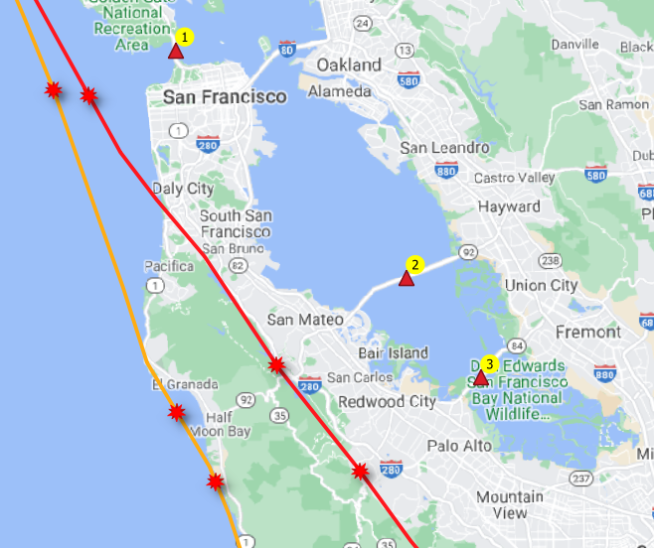
Case Study
Parameters | Golden Gate Bridge | San Mateo-Hayward Bridge | Dumbarton Bridge
Location on Map | 1 | 2 | 3
Replacement Value (2019 $) | $ 523 Million | $ 418 Million | $ 182 Million
Sources | Color On Map | Source Set | Return Period
San Andreas (Peninsula) | Red | UC33brAvg_FM31, UC33brAvg_FM32 | 475, 975, 2475
San Gregorio (North) | Orange | UC33brAvg_FM31, UC33brAvg_FM32 | 475, 975
Fig. Location of Bridges and common faults affecting them

Slide 9
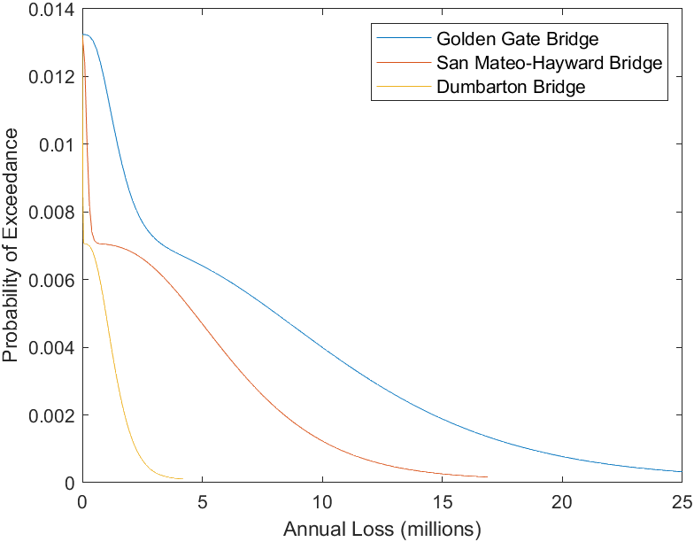
Result and Conclusion
Parameters | Golden Gate Bridge | San Mateo-Hayward Bridge | Dumbarton Bridge
Hazard Range for the location SA(1.0s) (g) | 0.18 – 0.24 | 0.10 – 0.18 | 0.10 – 0.18
Average Annual Loss | $ 93,524.57 | $ 50,093.06 | $ 10,439.35
Resilience | 2.9403 | 2.9651 | 2.9927
Fig. AEP Curves for the three bridges
Priority of Retrofit
Highest AAL First : Golden Gate -> San Mateo-Hayward -> Dumbarton
Lowest Resilience First : Golden Gate -> San Mateo-Hayward -> Dumbarton

Slide 10
Scope of Future Work
Integration of Network analysis and effect on Traffic Flow
Effect of a bridge’s damage on the traffic flow
Indirect costs associated with detours
Inclusion of environmental aspects
Increased Carbon-footprint due to detours
Environmental impact due to reconstruction
Integration of Bridge’s Age and past Retrofits
Effect on bridge’s strength due to age and retrofit
Expansion to other critical structures
Water supply system, waste water system, hospitals

